Slide 1
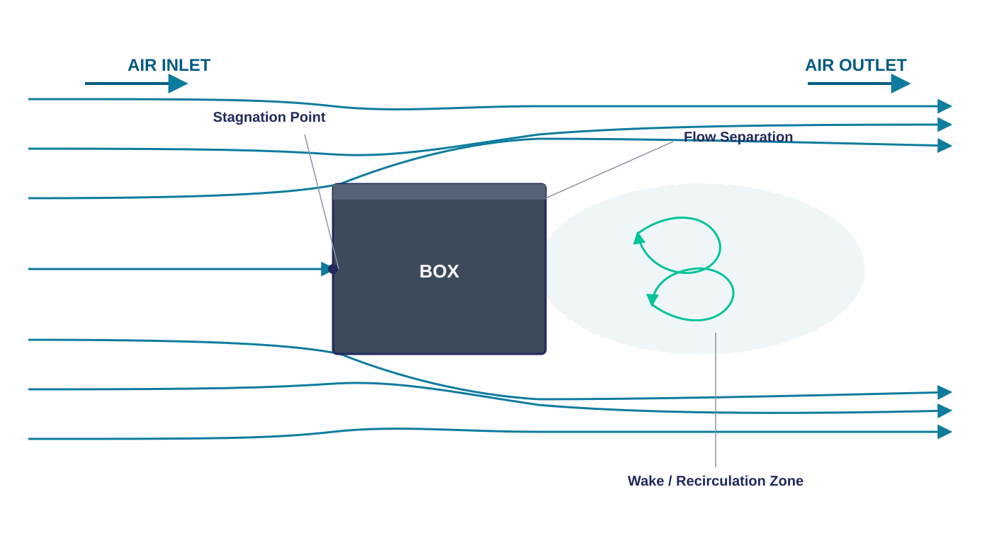
CFD WORKFLOW
Airflow Around a Box
A SolidWorks Flow Simulation Process
From geometry setup to mesh, solver, and post-processing —
a complete external-flow CFD case study.
Computational Fluid Dynamics | SolidWorks Flow Simulation

Slide 2





1
PROCESS OVERVIEW
The Five-Stage Flow Simulation Workflow
Every external airflow study in SolidWorks follows the same structured pipeline.
1
2
3
4
5
Geometry &
Domain
Meshing
Boundary
Conditions
Solver &
Convergence
Post-
Processing
Define the box and the surrounding computational domain
Generate global and locally refined mesh
Set inlet velocity, pressure & goals
Run iterative solution to convergence
Visualize velocity, pressure & wake
SOLIDWORKS FLOW SIMULATION • AIRFLOW AROUND A BOX
2

Slide 3
1
STEP 1 OF 5
Geometry & Computational Domain
Box Geometry — The solid box model is built or imported as a SolidWorks part — its faces define the wall boundary the air must flow around.
Computational Domain (Enclosure)
Enclosure / Wind Tunnel — An external-flow analysis requires an enclosure (computational domain) surrounding the box to represent the surrounding air volume.
BOX
Domain Sizing — Inlet placed upstream, outlet downstream, with side walls far enough away to avoid artificial blockage of the flow.
Symmetry — Symmetry planes can be used to reduce computation if the box and flow are symmetric, cutting solve time significantly.
Inlet
Outlet
SOLIDWORKS FLOW SIMULATION • AIRFLOW AROUND A BOX
3

Slide 4
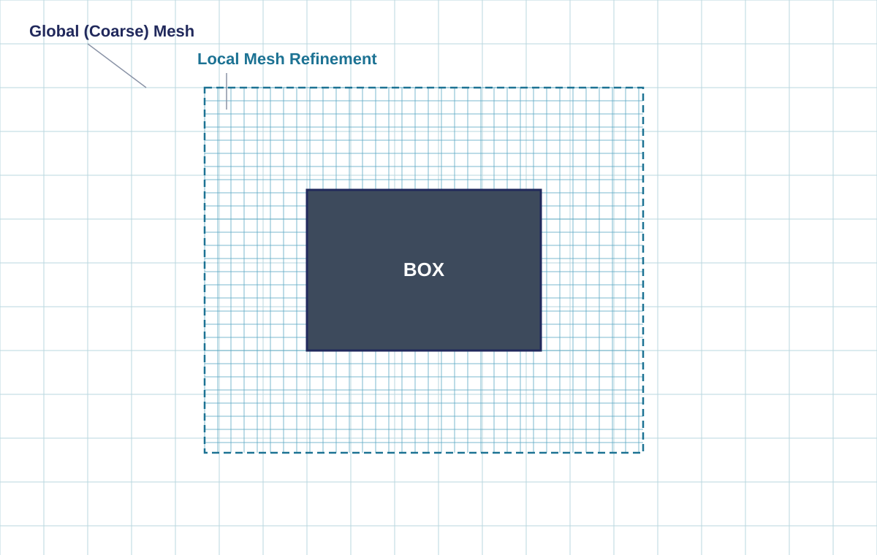




2
STEP 2 OF 5
Mesh Generation
SolidWorks Flow Simulation uses a Cartesian, octree-based mesh that automatically refines near solid boundaries.
Global Mesh
A coarse Cartesian mesh fills the entire computational domain as a baseline resolution.
Local Mesh Refinement
Finer cells are applied around the box surfaces and the wake region, where gradients are steepest.
Boundary Layer Cells
Thin prismatic-like cells near walls capture the boundary layer and resolve flow separation accurately.
Tip: Mesh density directly affects how well separation points and the wake behind the box are captured.
Mesh Quality Check
Aspect ratio and cell count are reviewed before solving to balance accuracy against runtime.
SOLIDWORKS FLOW SIMULATION • AIRFLOW AROUND A BOX
4

Slide 5




3
STEP 3 OF 5
Boundary Conditions & Goals
Defining the physics of the simulation: how air enters, exits, and what results are tracked.
Inlet Velocity
Static Pressure Outlet
Wall Conditions
Engineering Goals
A uniform air velocity (e.g. 10 m/s) is applied at the upstream face of the domain.
Outlet face is set to ambient static pressure (101325 Pa) to allow free outflow.
The box surfaces are defined as no-slip, adiabatic real walls; default roughness.
Goals are defined for drag force, surface pressure, and average velocity for convergence tracking.
Fluid: Air (ideal gas) Flow Type: External, Turbulent (k-ε) Analysis: Steady-State
SOLIDWORKS FLOW SIMULATION • AIRFLOW AROUND A BOX
5

Slide 6
4
STEP 4 OF 5
Solver & Convergence Monitoring
Iterative Solution Process
The solver marches through iterations, solving the Navier-Stokes and turbulence (k-ε) equations on every mesh cell until residuals stabilize.
Goal Convergence — Drag Force Residual
Goals (drag, pressure, velocity) are tracked live during solving
Convergence is reached when goal values flatten within tolerance
Solver auto-refines mesh in high-gradient regions (adaptive refinement)
Run is stopped automatically once criteria are satisfied
Converged. Residuals dropped below the 1% target after ~250 iterations, indicating a stable steady-state solution.
SOLIDWORKS FLOW SIMULATION • AIRFLOW AROUND A BOX
6

Slide 7
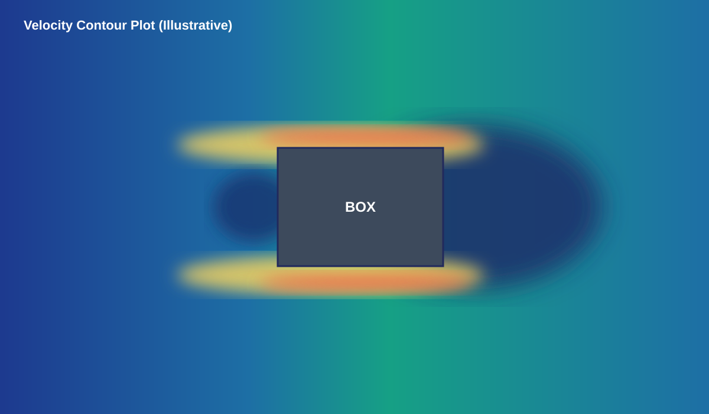
5
STEP 5 OF 5
Post-Processing & Flow Visualization
Once converged, SolidWorks generates cut plots, surface plots, and streamlines to interpret the airflow behavior.
Velocity Cut Plot
Shows acceleration over the top/bottom edges and a low-velocity wake behind the box.
Pressure Plot
Highlights high pressure at the stagnation face and a low-pressure region in the wake.
Surface Streamlines
Traces flow direction along box faces, revealing separation lines.
Flow Trajectories
3D particle traces visualize vortex shedding and recirculation downstream.
SOLIDWORKS FLOW SIMULATION • AIRFLOW AROUND A BOX
7

Slide 8
★
FLOW PHYSICS
What Happens as Air Meets the Box
SOLIDWORKS FLOW SIMULATION • AIRFLOW AROUND A BOX
8

Slide 9
✓
RESULTS SUMMARY
Key Simulation Results
Representative output values from a single steady-state run at 10 m/s inlet velocity.
1.05
13.4 m/s
-42 Pa
2.3× box width
Drag Coefficient (Cd)
Peak Velocity (top edge)
Min. Pressure (wake)
Wake Length
Observed Flow Behavior
Flow accelerates sharply around the leading top/bottom edges of the box
A large recirculating wake forms downstream, dominated by two counter-rotating vortices
Pressure is highest on the windward face and lowest within the wake region
Drag is dominated by pressure (form) drag rather than skin friction, typical of bluff bodies
SOLIDWORKS FLOW SIMULATION • AIRFLOW AROUND A BOX
9

Slide 10
Conclusion
1
Structured Workflow
Geometry, mesh, boundary conditions, solve, and post-processing form a repeatable CFD pipeline.
2
Bluff-Body Behavior
The box exhibits classic bluff-body flow: stagnation, edge separation, and a large recirculating wake.
3
Design Insight
Cut plots and goal trends translate directly into actionable drag and pressure data for design decisions.
Thank you
SOLIDWORKS FLOW SIMULATION • AIRFLOW AROUND A BOX
10

